Slide 1
Model Context Protocol Building AI Agents with CrewAI & LiteLLM
Anbei Zhao
MADE BY
WAJAHAT HUSSAIN

Slide 2
Understanding Model Context Protocol (MCP)
Definition
Primary Goal
Key Features
MCP is an open standard created by Anthropic that provides a secure, standardized way for AI assistants (e.g., Claude) to interact with external data sources such as GitHub, Google Drive, Slack, and more.
Enhance AI capabilities by allowing access to real-time, relevant data and context, thereby generating more accurate responses.
Universal Connectivity: One standardized method to interface with multiple data sources.
Client-Server Architecture: Differentiates between MCP Hosts (client applications) and MCP Servers (data/function providers).
Secure Data Access: Controlled sharing of information with robust security.

Slide 3
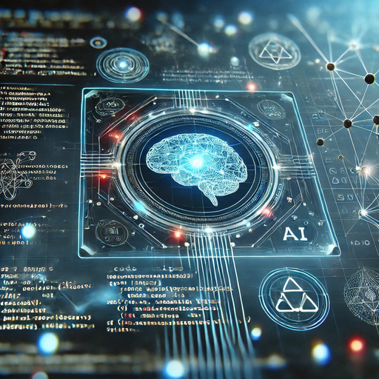


Key Features of
Model Context Protocol
Universal Connectivity:
Client-Server Model:
Secure Data Access:
Streamlines integration by eliminating the need for custom connectors for every data type.
Clearly defined roles with MCP Hosts initiating connections and MCP Servers providing data/services.
Ensures that data is only shared in a controlled and secure manner.

Slide 4
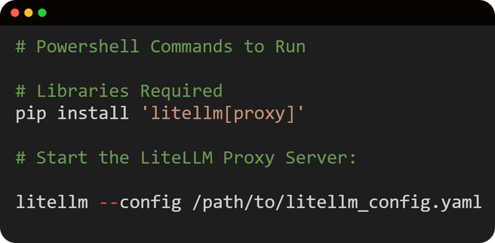
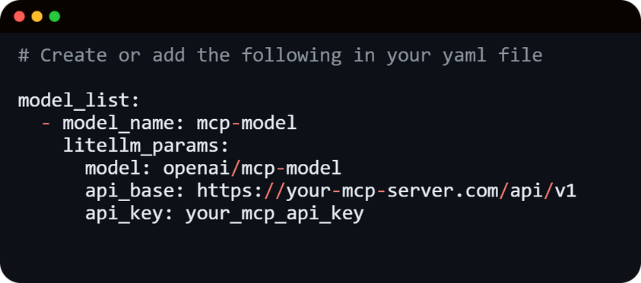
Integrating MCP with LLM Gateway
CrewAI integrates with multiple LLM providers through LiteLLM, giving you the flexibility to choose the right model for your specific use case.
Benefits of MCP Integration:
Standardized Data Access: Uniform interface for AI agents to securely access multiple external data sources.
Enhanced Agent Capabilities: Ability to leverage tools (e.g., IBM’s watsonx.ai) through a single protocol.
Simplified Integration: Reduces the need for building custom connectors.

Slide 5

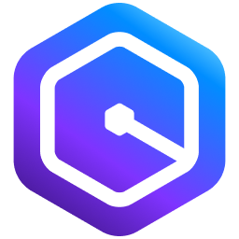

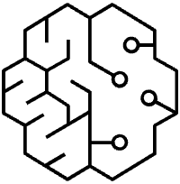



Generative AI stack
APPLICATIONS TO BOOST PRODUCTIVITY
Amazon Q Business
INSIGHTS AND AUTOMATION
Amazon Q Developer
SOFTWARE DEVELOPMENT LIFE CYCLE
MODELS AND TOOLS TO BUILD GENERATIVE AI APPS
Amazon Bedrock
AMAZON MODELS | PARTNER MODELS
INFRASTRUCTURE TO BUILD AND TRAIN AI MODELS
Amazon SageMaker
Managed Infrastructure
AWS Trainium
AWS Inferentia
GPUs
HIGH PERFORMANCE COMPUTE
© 2025, Amazon Web Services, Inc. or its affiliates. All rights reserved. Amazon Confidential and Trademark.
5
Notes:
Here at Amazon Web Services, we like to think of the fundamentals for generative AI as a 3-layer stack that supports our customers’ unique use case needs, wherever they are in their gen AI journey.
Bottom Layer
On the bottom, these are the most comprehensive infrastructure services to build and train AI models. Customers use managed infrastructure services like Amazon SageMaker and high-performance compute services to quickly (and cost-effectively) build and train AI models.
Middle layer:
In the middle, customers use services like Amazon Bedrock to build generative AI applications…
Top layer:
And finally, at the top, customers use applications to boost productivity like Amazon Q Business for insights and automation, and Amazon Q Developer for accelerating the software development life cycle.

Slide 6
Helps developers and IT professionals build faster across the entire software development lifecycle (SDLC)
Most accurate coding recommendations
Agents can autonomously help you implement features, refactor code, perform software upgrades and more
Amazon Q is an expert on AWS and optimizing AWS environment
Best-in-class security vulnerability scanning and remediation
Amazon Q Developer
Amazon Q is built with security and privacy in mind from the start, making it easier for organizations to use generative AI safely.
Notes:
Amazon Q Developer is the most capable generative AI–powered assistant for software development, and is transforming how builders work with AWS.
Q Developer has best in-class security scanning and remediation, and it has the highest reported code acceptance rate of any coding assistant that suggests multi-line code, with customers like National Australia Bank reporting up to 50% of code suggestions accepted. Amazon Q Developer’s unique generative AI capabilities support development far beyond coding. Q Developer is uniquely capable of accelerating software development by as much as 80% by going far beyond coding recommendations to autonomously planning and executing multi-step projects; like building a new application feature or modernizing a legacy application.
From writing code or performing advanced upgrades in the IDE, to chatting about architectural best practices in the AWS console, we’re taking a more end-to-end approach by solving problems across the software development lifecycle.

Slide 7
Workshop structure
├── crewai-with-mcp
│ ├── src
│ │ └── mcpwhs
│ │ ├── __init__.py
│ │ ├── config
│ │ │ ├── agents.yaml
│ │ │ └── tasks.yaml
│ │ ├── crew.py
│ │ ├── main.py
│ │ └── tools
│ │ └── mcp_tools.py
└── crewai_tools
├── pyproject.toml
├── src
│ └── mcp_research
│ ├── __init__.py
│ ├── config
│ │ ├── agents.yaml
│ │ └── tasks.yaml
│ ├── crew.py
│ ├── main.py
│ └── tools.py

Slide 8
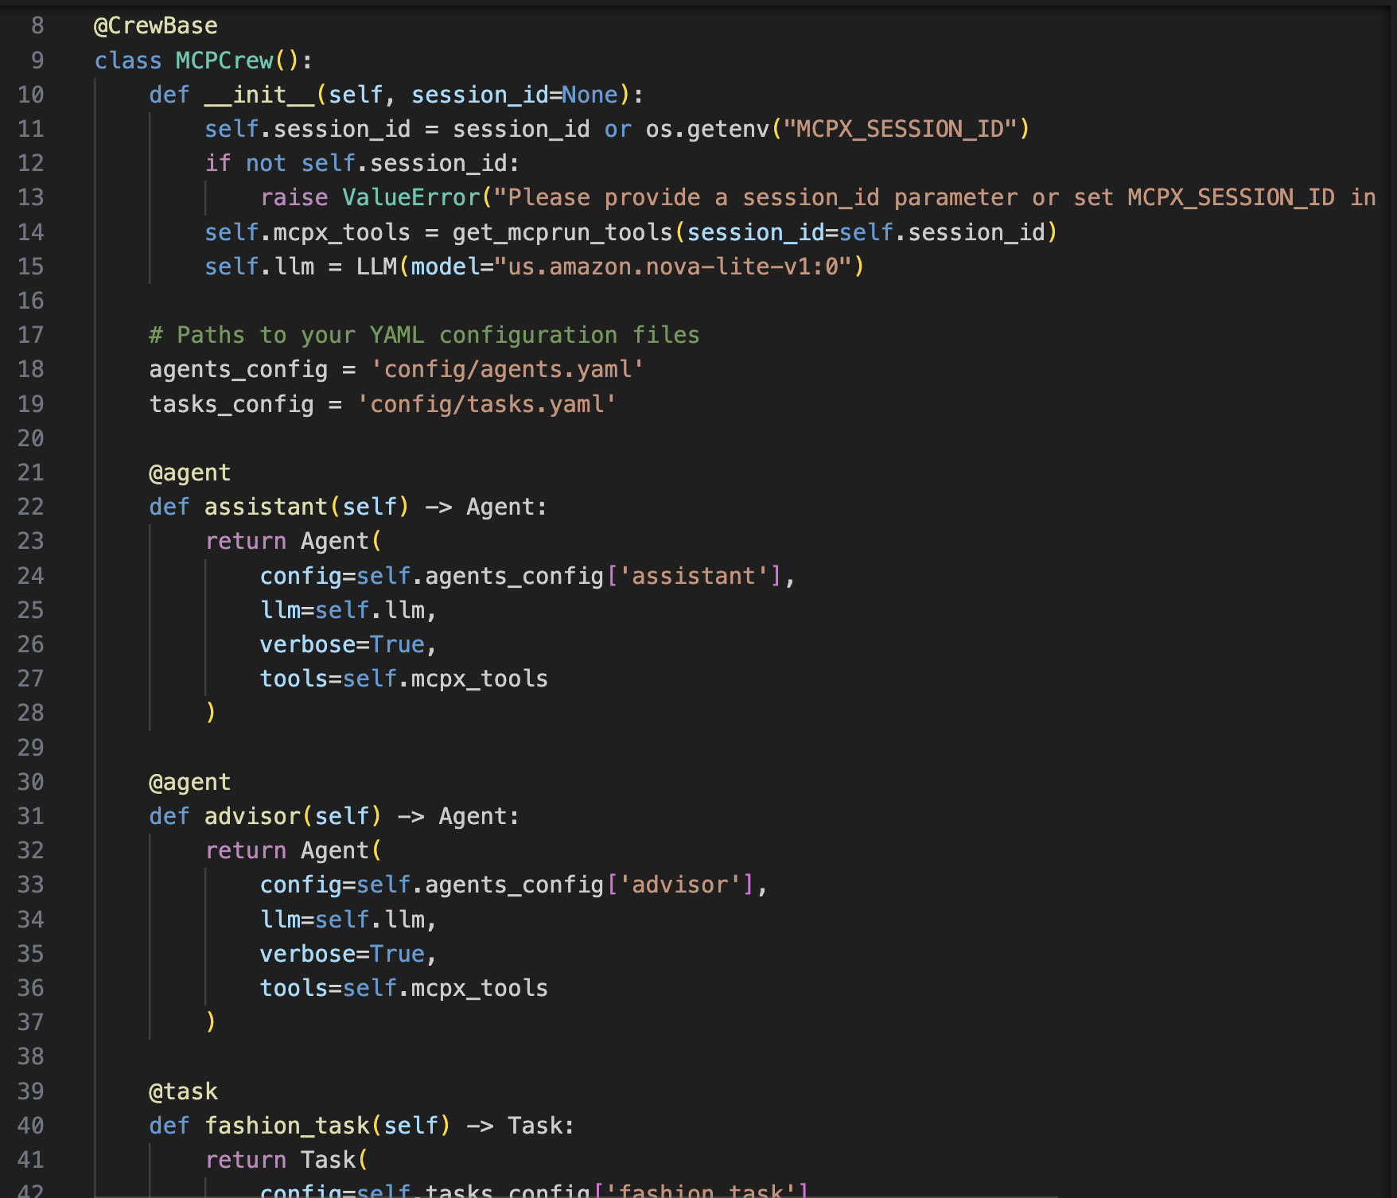
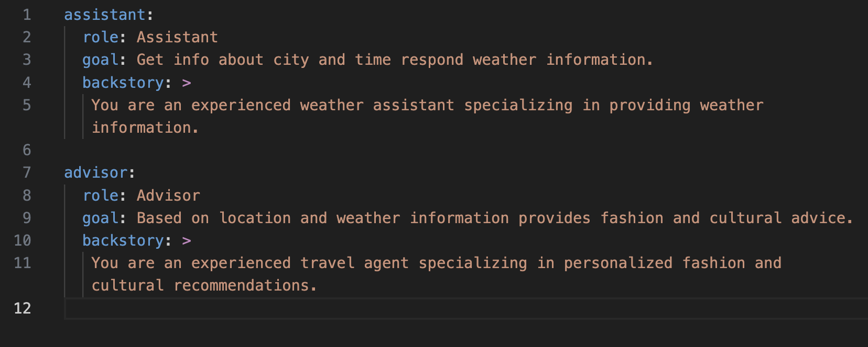
Amazon Q developer 辅助代码生成

Slide 9
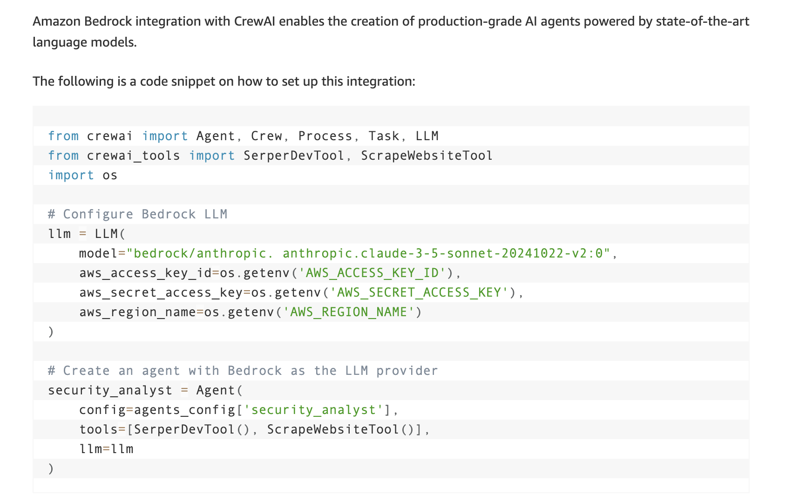
CrewAI(Litellm) config
https://aws.amazon.com/cn/blogs/machine-learning/build-agentic-systems-with-crewai-and-amazon-bedrock/

Slide 10
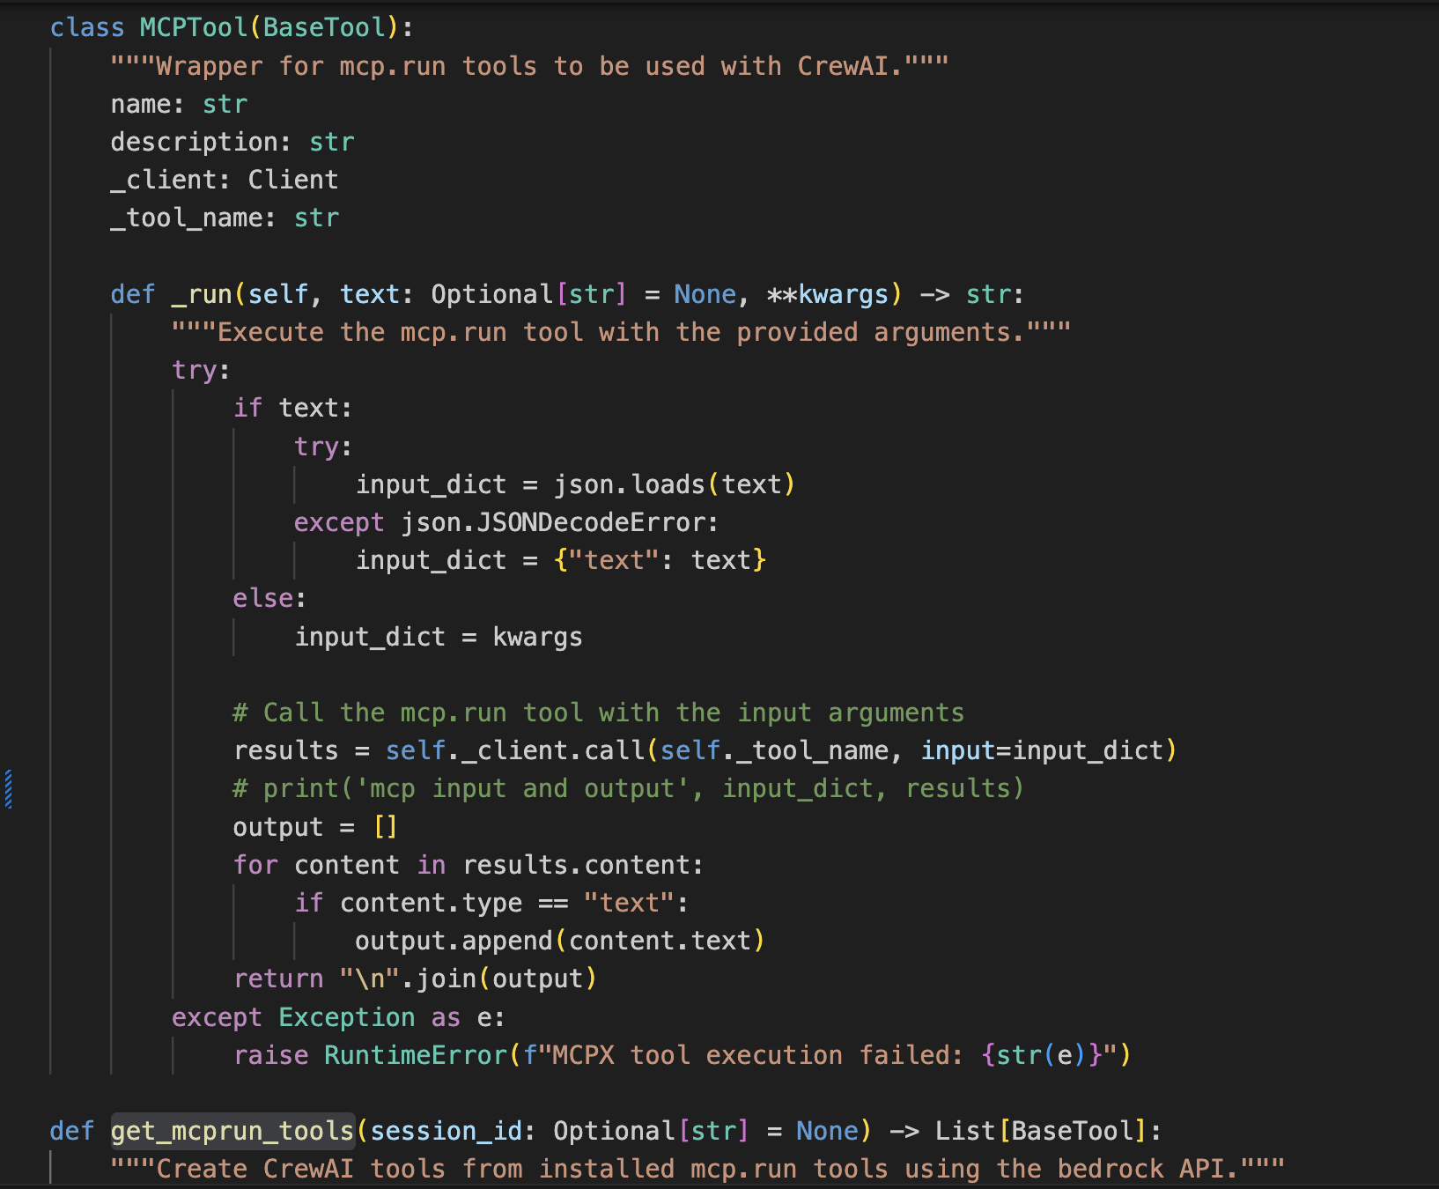
MCP wrapper

Slide 11
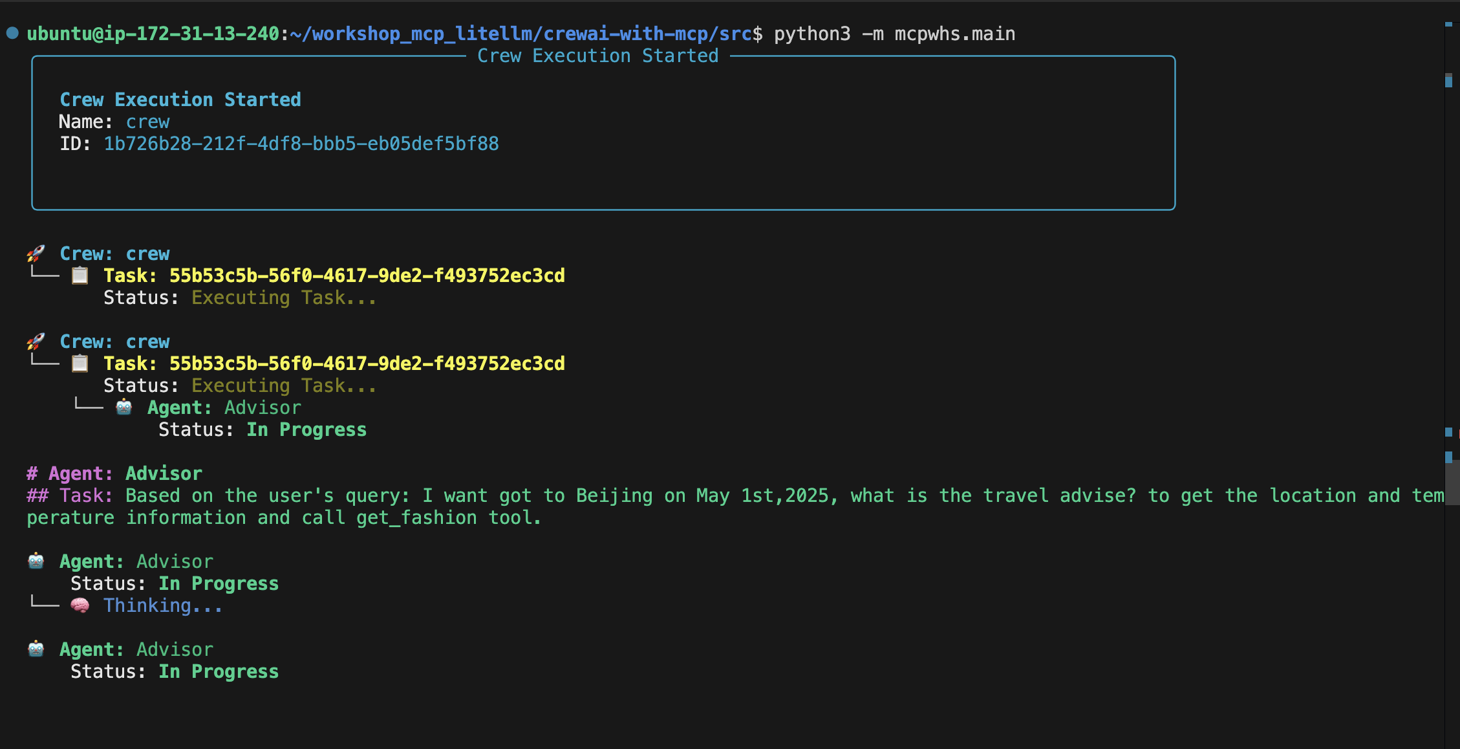
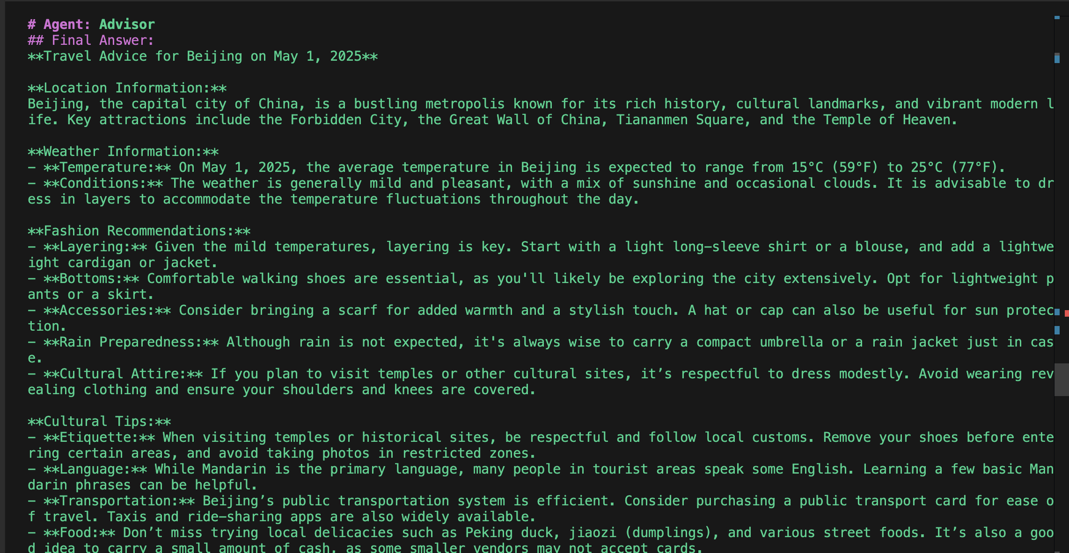
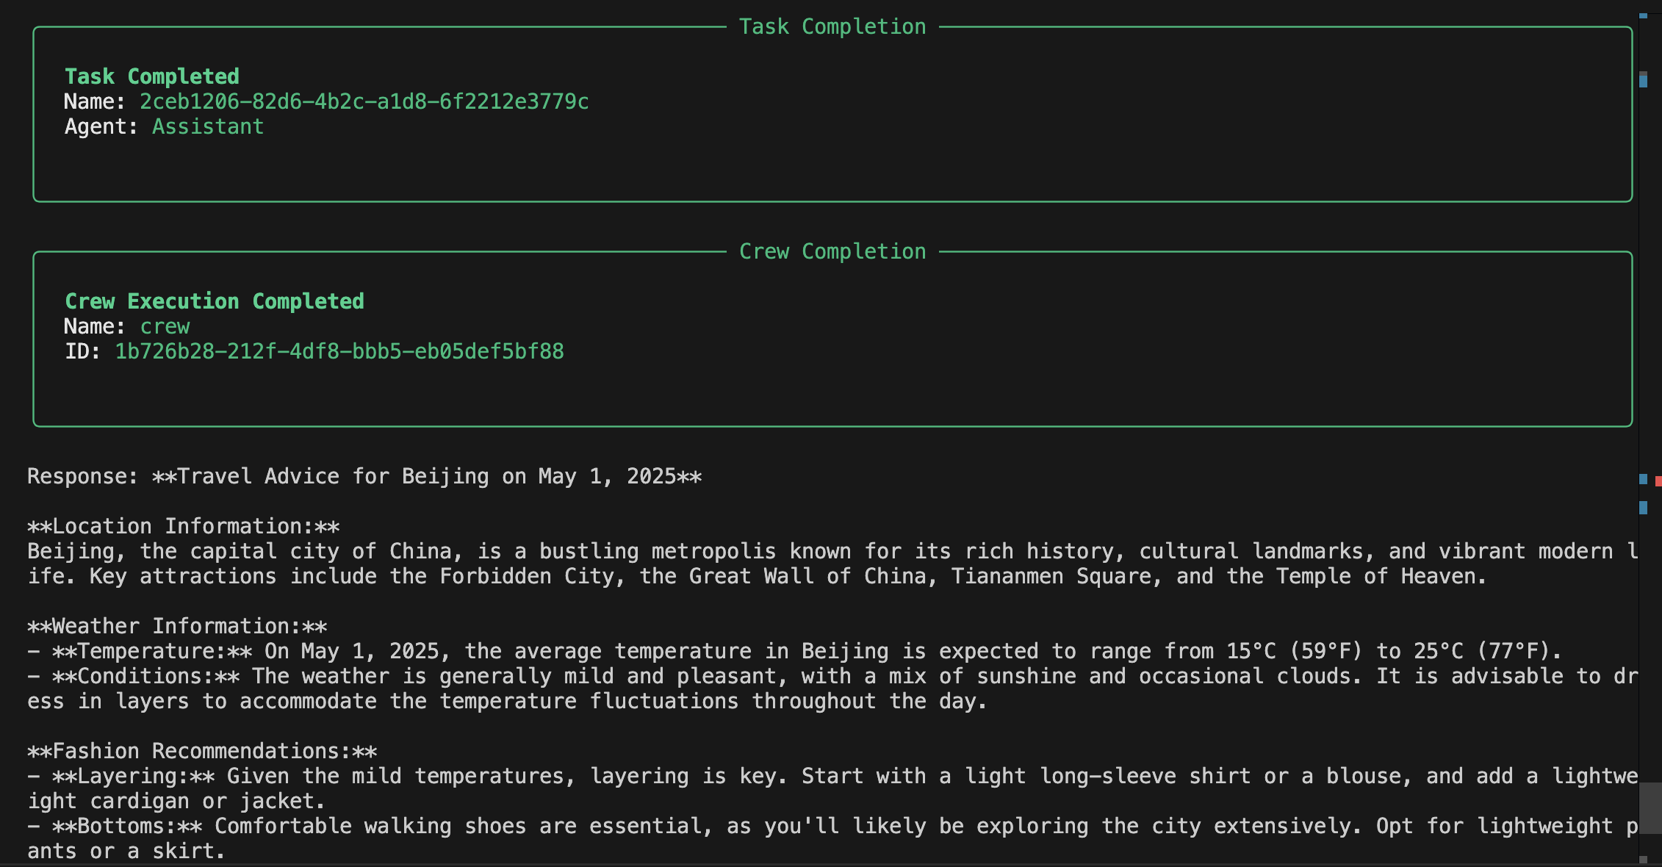
运行效果

